Slide 1
Microprocessor Comparison
Author: Tyler Paddock

Slide 2
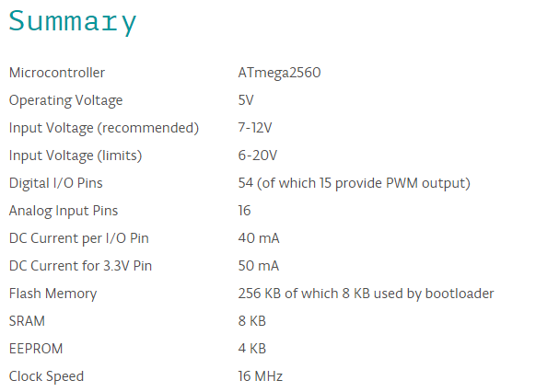
Arduino Specifications

Slide 3
Arduino Summary
54 GPIO
16 Analog pins
256KB flash memory (program memory)
MATLAB/Simulink support
Automated Installation and Configuration
Library and Simulink blocks for GPIO, UDP, TCP/IP
Interactive parameter tuning
Model deployment
16 MHz Clock
No OS, All C code in a “forever” loop
$45 - $50

Slide 4
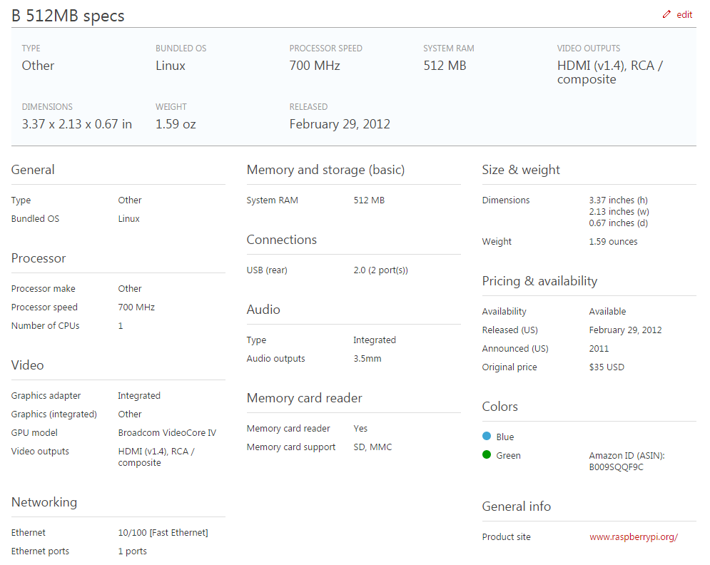
Raspberry Pi Specs

Slide 5
Raspberry Pi Summary
17 GPIO
MATLAB/Simulink Support
Automated Installation and Configuration
Library and Simulink blocks for GPIO, UDP
Interactive parameter tuning
Model deployment
700 MHz clock
Linux OS Support
$35

Slide 6
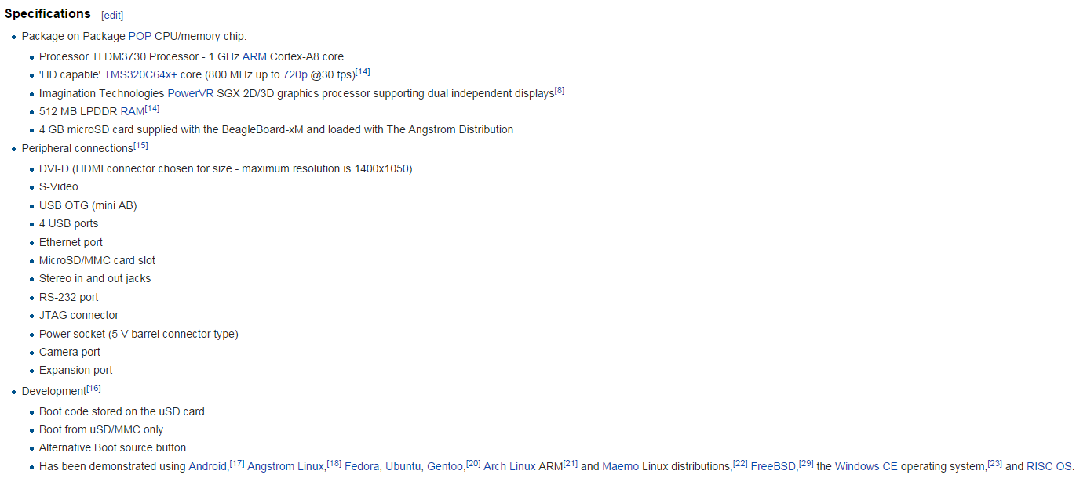
BeagleBoard –xM Specs

Slide 7
BeagleBoard –xM Summary
66? GPIO
Comes with 4GB memory. Is that used as program memory?
MATLAB/Simulink Support
Automated Installation and Configuration
Library and Simulink blocks for GPIO, UDP
Interactive parameter tuning
Model deployment
1GHz clock
Linux OS Support
$149

Slide 8
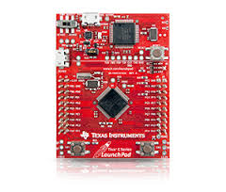
Tiva Series controllers from Texas Instruments
Tiva Series Controllers have many different configurations.
The one most likely used has these features
40 GPIO
MATLAB Simulink Coder™ and Embedded Coder™ support
80MHz Clock
Extreme low cost

Slide 9
Processor Recommendation #1
My recommendation is to use a Beagleboard –xM board
Despite being the most expensive it has all the advantages of the other boards plus a 1 GHz processor.
The Raspberry Pi has too few GPIO pins for any expansion needed in the project.
Arduino has a low speed and no advantages other than cost
MATLAB Model deployment allowed

Slide 10
Processor Recommendation #2
Second choice is Arduino Mega
Despite the speed disadvantage the Arduino board has plenty of IO
The microcontroller is MATLAB supported and program can be pushed onto the microcontroller
Still relatively low cost

